Slide 1
TESTING GENERATOR ROTOR WINDINGS
USING THE RSO TEST METHOD
ROWTEST LTD.

Slide 2
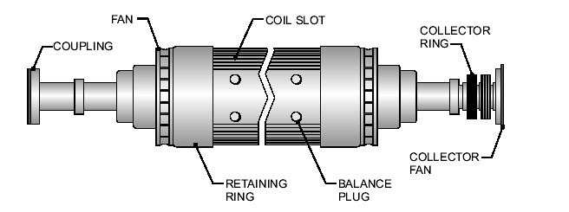
Large high-speed electrical generators use a rotating magnetic field produced by a cylindrical rotor in the form of a electromagnet having either 2 or 4 magnetic poles. The rotor body is a solid steel forging containing radial slots for the coils which make up the electromagnets (rotor windings).
The turns of the coils are rectangular copper bars, insulated with an epoxy material and in a 2-pole rotor, there are typically 8 pairs of slots for each pole of the electromagnet.

Slide 3
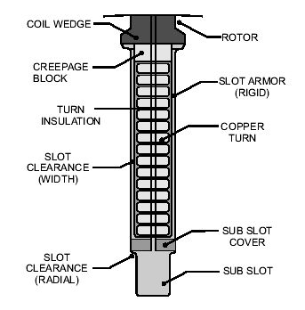
Each winding slot contains up to 20 conductor turns. The figure shows a cross-section of a typical radial slot (in this case, containing 15 turns of insulated copper bar).
At the ends of the rotor body, the turns pass from the end of one slot to its equivalent slot on the other side of the magnetic pole and are held in place in the end regions by steel end rings. A direct current of around 3000 amps flows through the rotor winding to produce the magnetic field, which is at right-angles to the axis of rotation, with clearly-defined north and south poles.

Slide 4
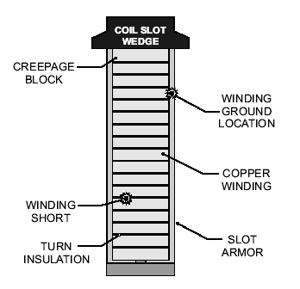
A 2-pole rotor rotates at 3000/3600 rpm to produce a 50Hz or 60Hz alternating voltage in the (3-phase) stator windings. The rotor windings experience large centrifugal forces, which can damage the insulation, leading to either shorts between the rotor winding and ground or between adjacent turns as shown in the figure.
As the DC current is large and the short circuits will have finite resistance, large quantities of heat can be generated at the fault location and this can cause damage to the remaining insulation, resulting in severe damage to the rotor windings.
Short circuits can also cause magnetic imbalance, giving rise to increased vibration levels.

Slide 5
Generator rotors are routinely tested to detect these types of fault, usually during construction and also before routine generator maintenance.
One standard test method used is based on the use of time-domain reflectometry (TDR), and is based on the methods used by telecommunications engineers to locate faults on telephone and data network transmission lines.
However, unlike the technique used for testing transmission lines, the rotor winding is a very imperfect transmission line and produces a large number of reflections at each change in impedance between the sections of conductors inside the radial slots and the sections in the cross-over end regions. This makes it virtually impossible to identify rotor winding faults by simply observing the TDR waveforms.
Consequently, a modified version of the TDR method must be used with rotor windings. A custom test instrument (Rotor Reflectometer) is used to carry out this test, which is known as the Recurrent Surge Oscilloscope (RSO) method by Power Engineers.

Slide 6
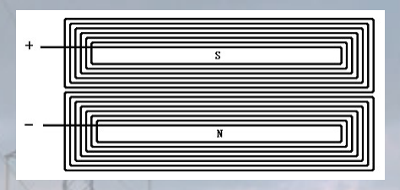
The RSO test method overcomes the problem of multiple reflections within the rotor winding. It can detect and locate earth faults or shorted turns in rotor windings and relies on the fact that the rotor winding is symmetrical. For example, a 2-pole rotor contains two nominally-identical half-windings, one for the North pole and the other for the South pole, both of which are connected in series as shown above. A four pole rotor is similarly symmetrical.

Slide 7
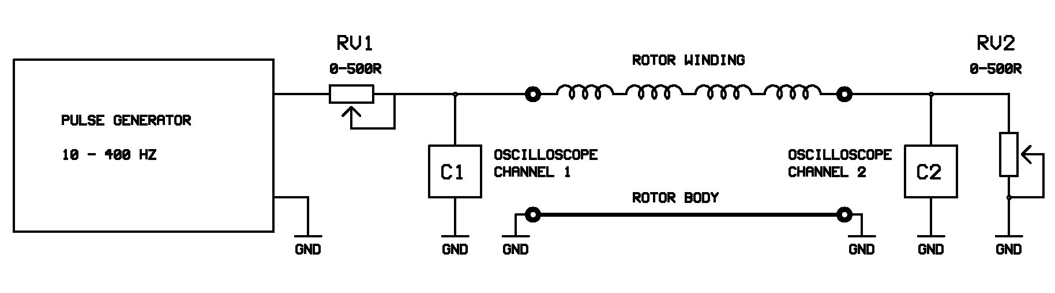
This symmetry property is used to compare the response of the 2 halves of the rotor winding to a voltage pulse applied between each slip-ring and the rotor body. The pulses and any reflected signals are monitored at each end of the rotor winding using an oscilloscope. If the rotor winding is fault-free, two identical waveforms will be observed at each slip ring. However, if one half-winding contains a fault, the two waveforms will differ.

Slide 8
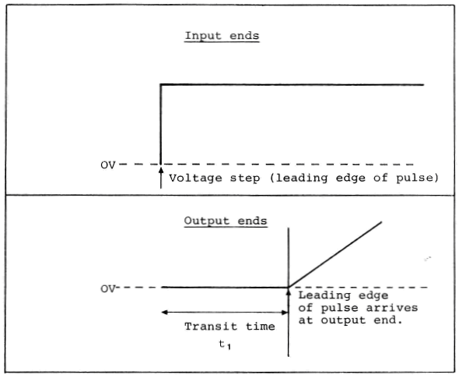
A (typically) square wave pulse (12V) is applied between one of the rotor slip rings and ground and the transmitted pulse received at the remote end of the rotor and the reflected pulse at the sending end are monitored.
The pulse takes a finite time (the transit time) to travel from one end of the winding to the other and emerges at the far end as a slowly rising ramp because of distortion effects in the winding.
Simplified (and idealised) versions of these waveforms are shown above.

Slide 9
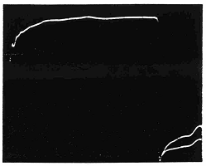
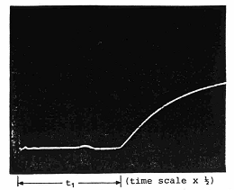
Input ends Output ends
The RSO test is carried out by applying pulses from each end of the rotor winding in turn and the oscilloscope traces at each end of the winding are recorded and compared. If the rotor is fault-free, the oscilloscope traces will be identical.
Examples of real waveforms for a fault-free rotor at the input and output ends of the rotor winding are shown in the figures above

Slide 10
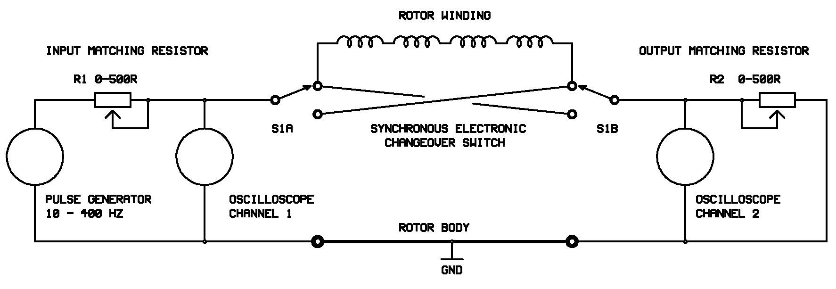
In practice, the TDR100 test instrument has a switching circuit which applies pulses alternately from each end of the rotor winding so that the waveforms are automatically superimposed when viewed on a single channel oscilloscope.

Slide 11
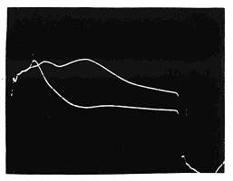
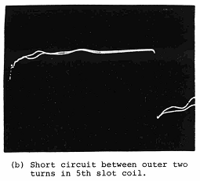
Short circuit to rotor body at end of 5th coil slot
(16 coils in winding)
When an earth fault occurs part way along the winding, the traces that occur are as shown above,
If there is an interturn fault, the waveform at the slip ring nearest the fault is characterised by a slight increase in voltage followed by a decrease down to a minimum, followed by a slow voltage rise, as shown above

Slide 12
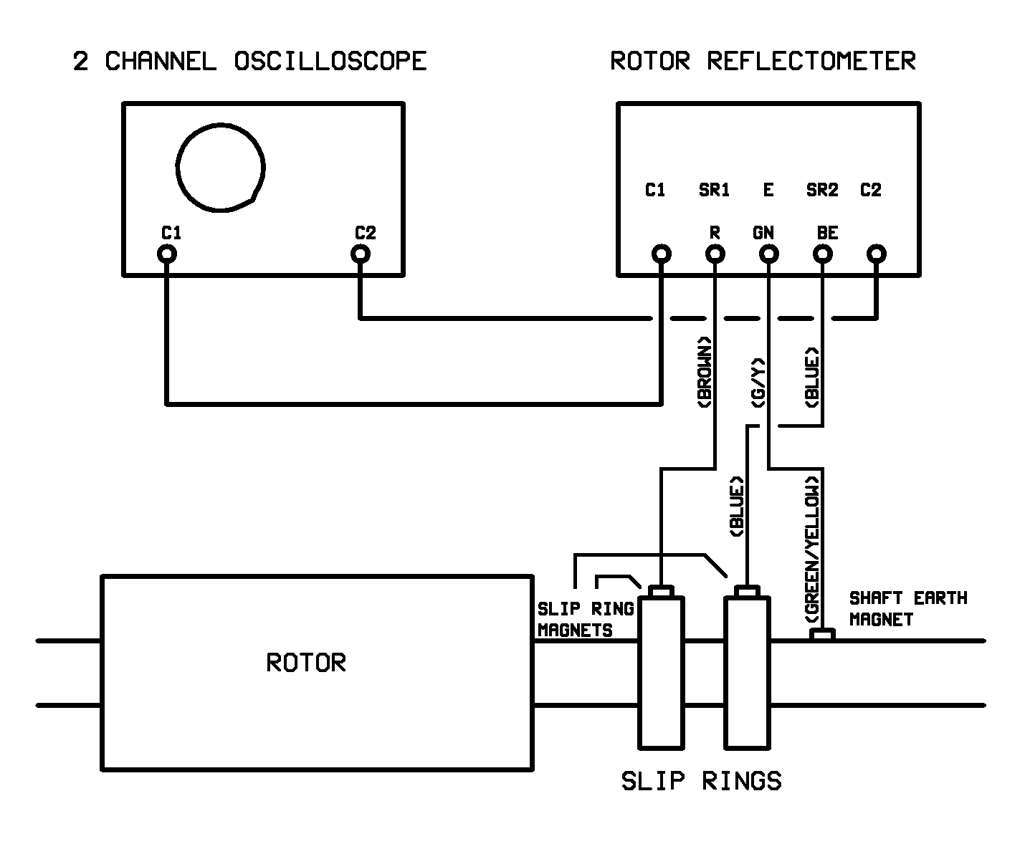
A typical measurement arrangement is shown above and in the next slide and assumes the use of a basic two channel analogue oscilloscope, although a single channel instrument will suffice if a 2-channel oscilloscope is not available.

Slide 13
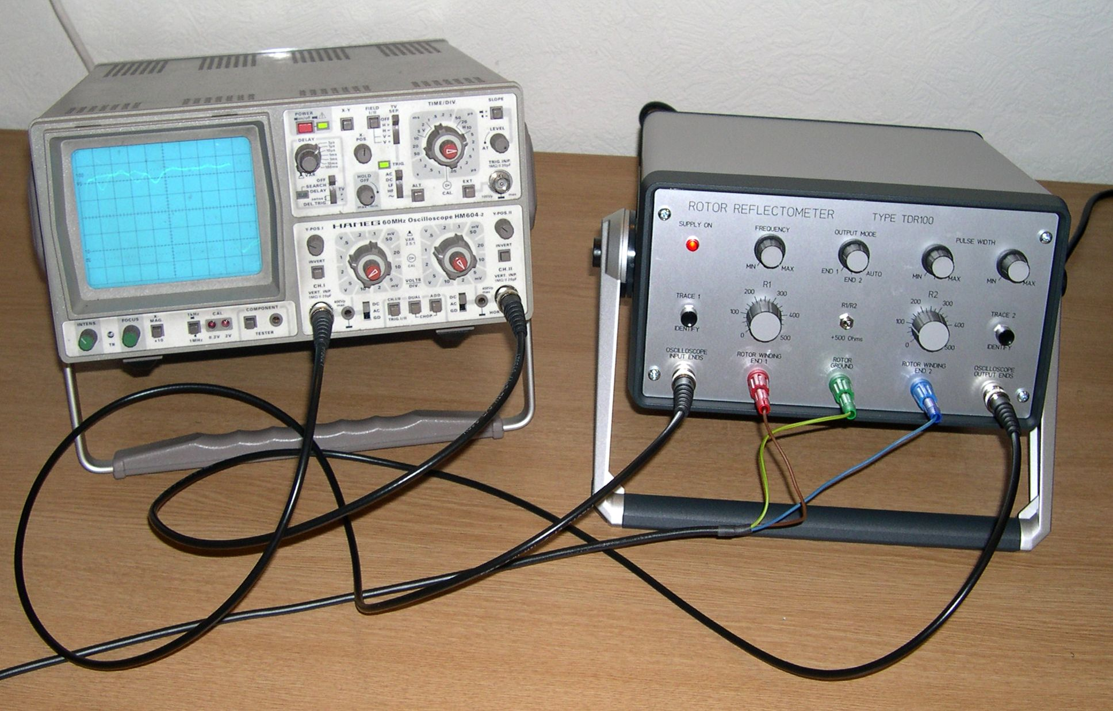
TDR100 RSO Measurement system

Slide 14
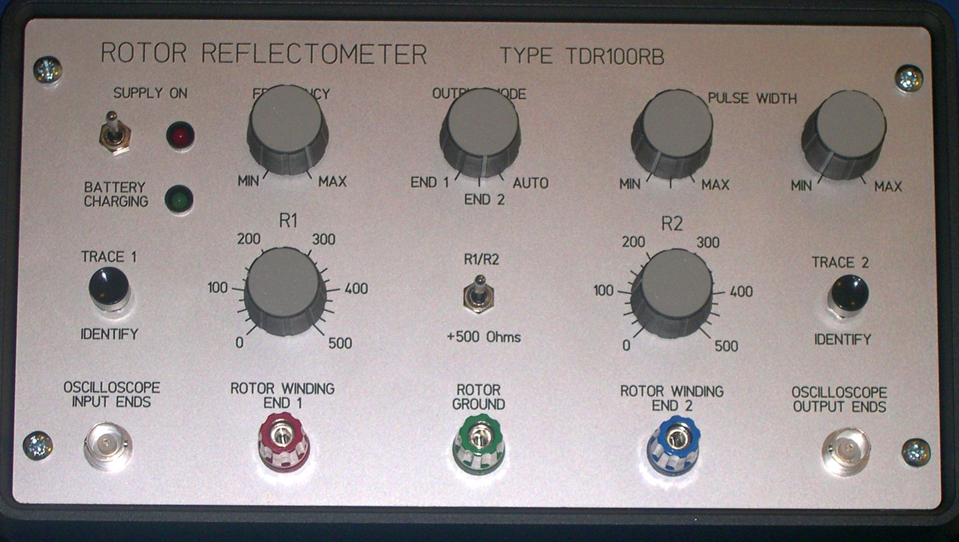
The photo shows the controls on the front panel of a Rowtest TDR100 Reflectometer. This is an analogue instrument which displays the rotor waveforms on an oscilloscope screen.

Slide 15
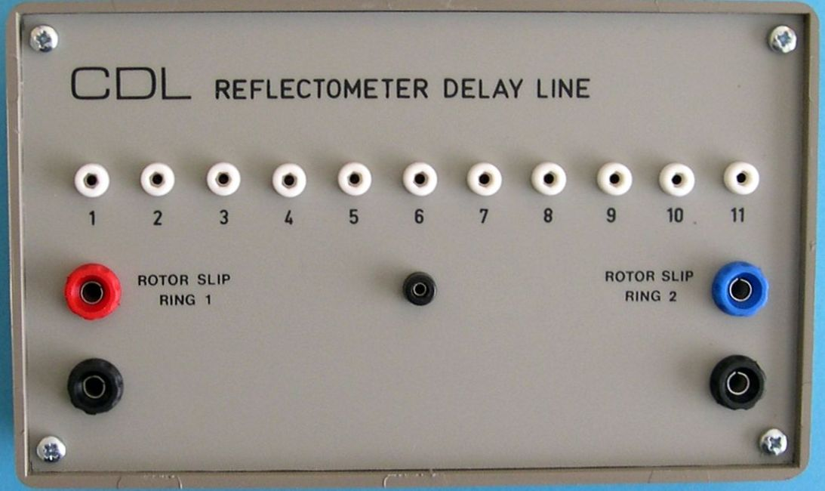
The operation of the Reflectometer can be demonstrated and checked using a delay line module, which simulates (approximately) the electrical characteristics of the rotor winding.

Slide 16
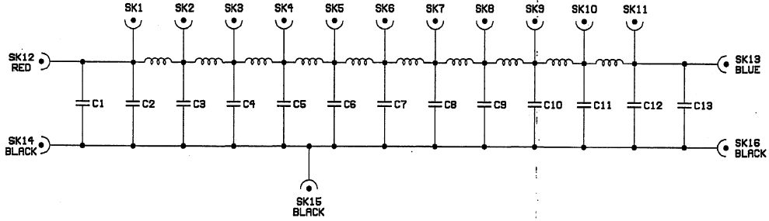
The delay line contains 10 sections of series inductance and parallel capacitance and is designed to produce a characteristic impedance of 100Ω and a propagation delay of 11μS.
The junctions between each section of the delay line are connected to a series of 2mm sockets, enabling external connection to these points. The input and output ends of the unit are connected to 4mm sockets.

Slide 17
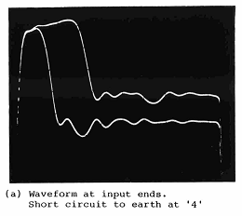
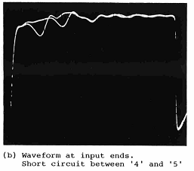
The effect of a simulated earth fault can be demonstrated by shorting one of the delay line junctions to earth using the 2mm plug leads. Fig. (a) shows the result of shorting junction 4 to earth.
Similarly the effect of a shorted turn can be demonstrated by shorting out one or more delay line sections as shown in Fig. (b).

Slide 18
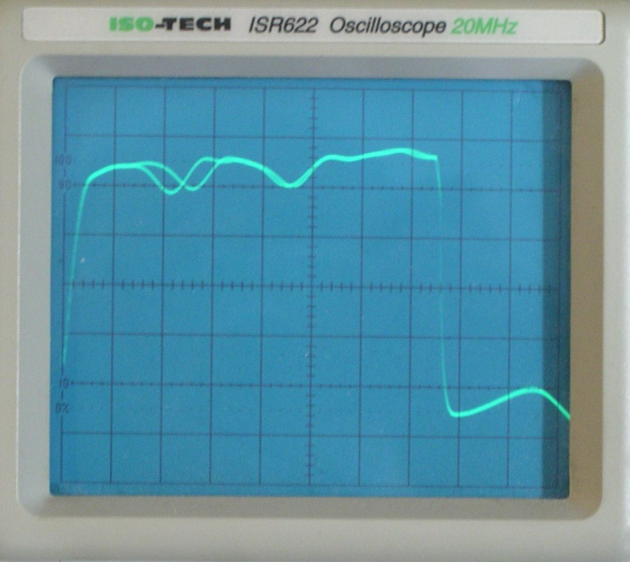
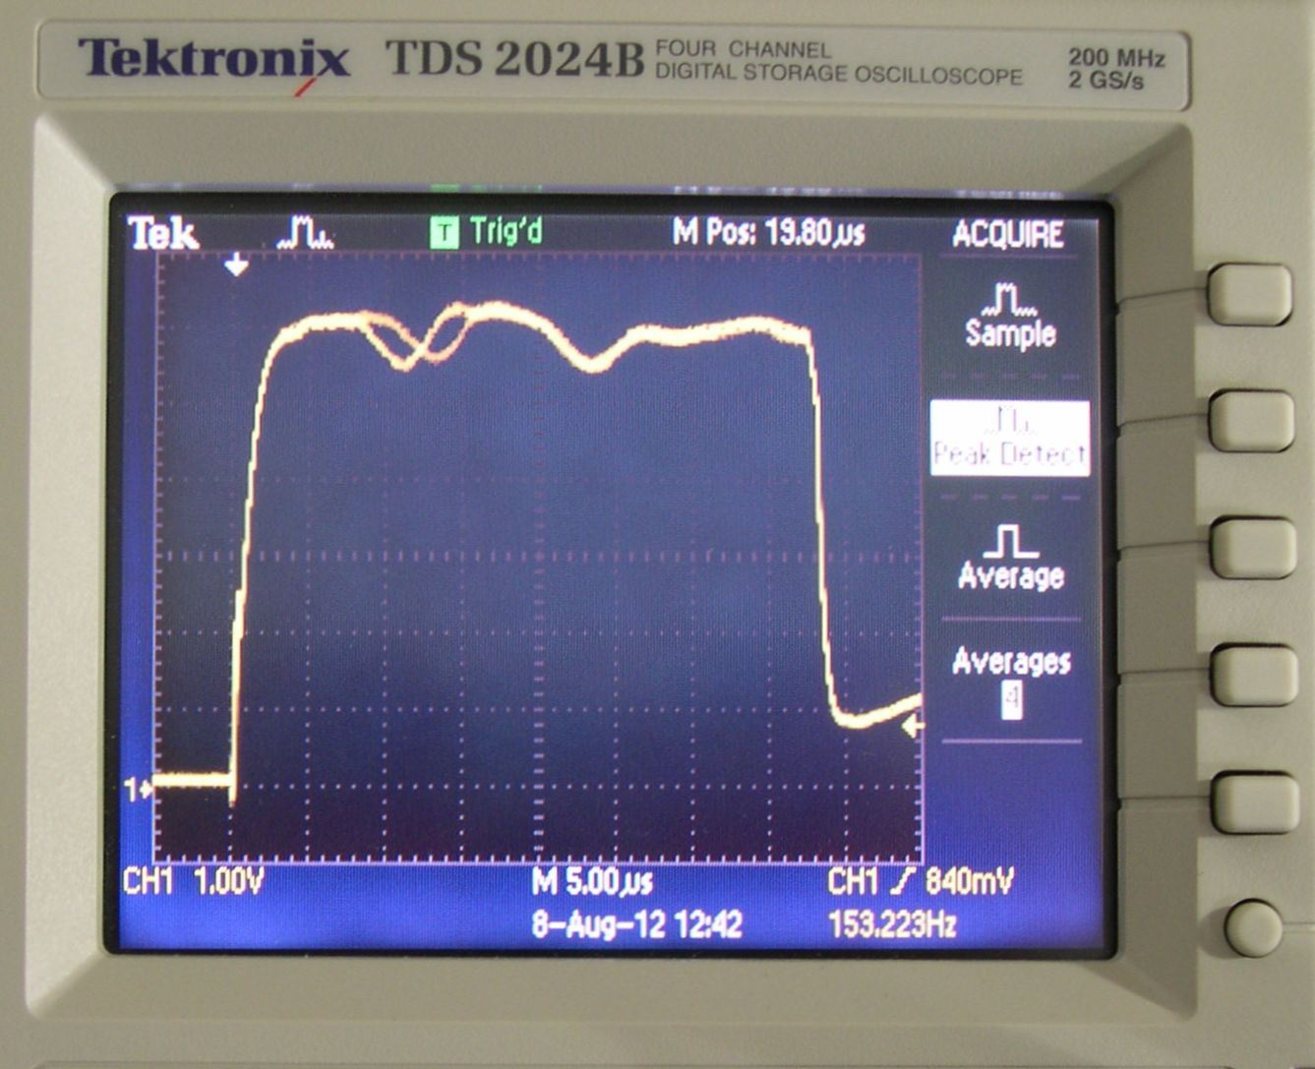
When the test method was first introduced, waveforms were often recorded using Polaroid photography. Currently, digital cameras are used with either analogue or digital oscilloscopes, as shown above.
When a digital oscilloscope is used, the waveform can also be captured to the oscilloscope’s internal memory and then transferred to a PC.

Slide 19
CONCLUSIONS
The RSO test is a safe (low voltage), sensitive and reliable method for detecting and locating faults in the windings of large generator rotors. It is in regular use for checking the integrity of rotor windings at Power Utilities, Manufacturers and Repair Companies throughout the world.
For further information, please contact us at enquiries@tomography.com
Copyright PTL. 2013.

